Slide 1

FOOD FACTORY MANAGEMENT SYSTEM
DATABASE FINAL-TERM PROJECT

Slide 2

THE PROJECT IS DONE BY :
IRTIZA AHSAN ABIR (21-45009-2)
ASHIK AHAMED (21-45368-2)
SRABONE RAXIT (21-45038-2)
KHANDAKER MAHADI AHMED (21-44683-1)
Supervised by Dr. S.M. HASAN Mahmud
SECTION : G

Slide 3
TABLE OF CONTENTS
01
03
05
02
04
06
ER-DIAGRAM
QUERIES
VALUE-INSERT
an entity relationship model
based on table and entity
Inquiry about a set of data
TABLE CREATION
NORMALIZATION
CONCLUSION
based on project topic
organizing data in a database
end of the event

Slide 4

SCENARIO
1.In our “Food Factory Management System” we include food factory,worker, stock, food, customer, visitor, machine, and records.
2.There is total 8 entities. We include relationship between food factory, worker, stock, food, customer, visitor, machine, and records which are acting as entities. Here, rectangle shapes represent the entities, ellipse shapes represent the attributes of the entities, and the diamond shapes represents the relationship between two entities.

Slide 5
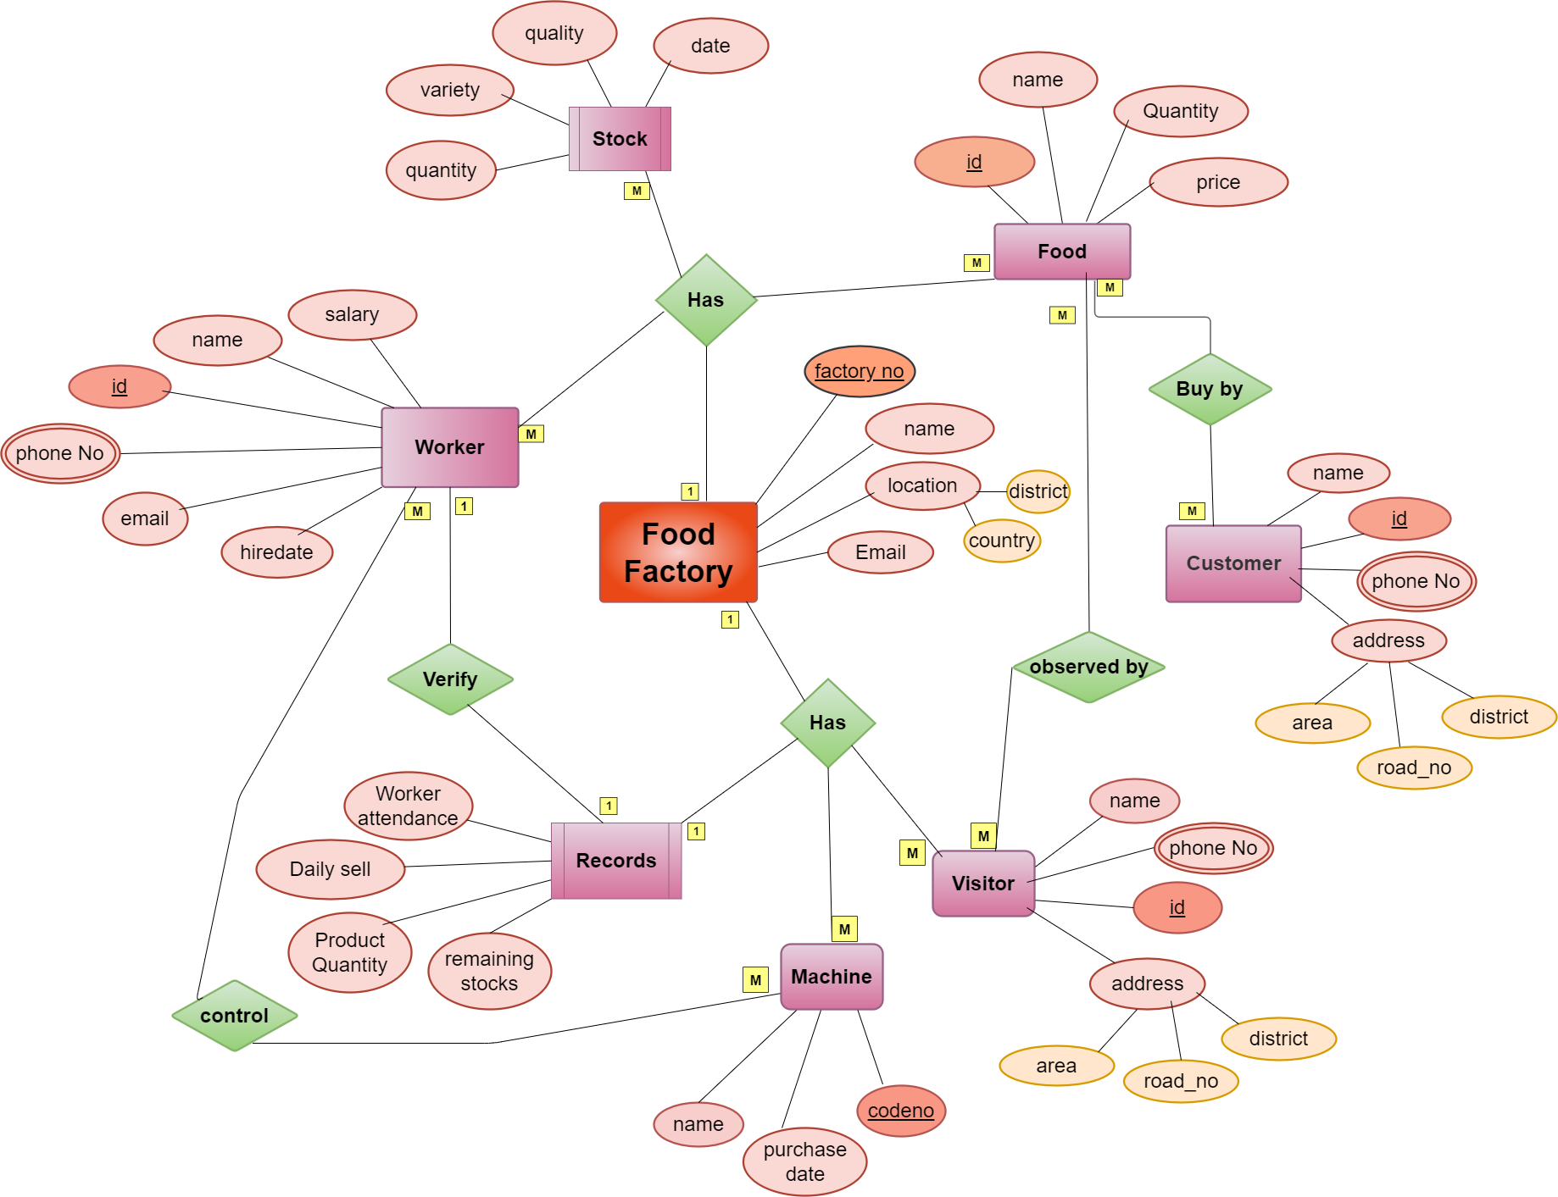
ER-DIAGRAM
01

Slide 6
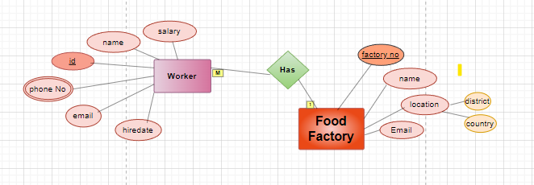
RELATIONSHIP BETWEEN ENTITY
Food factory has worker
One food factory has many workers

Slide 7
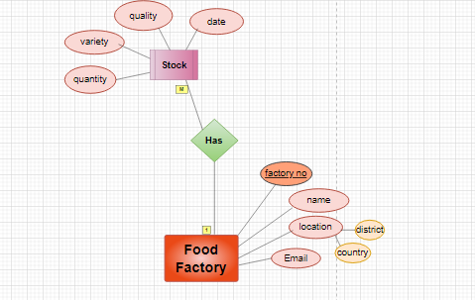
RELATIONSHIP BETWEEN ENTITY
Food factory has stock
One food factory has many stock

Slide 8
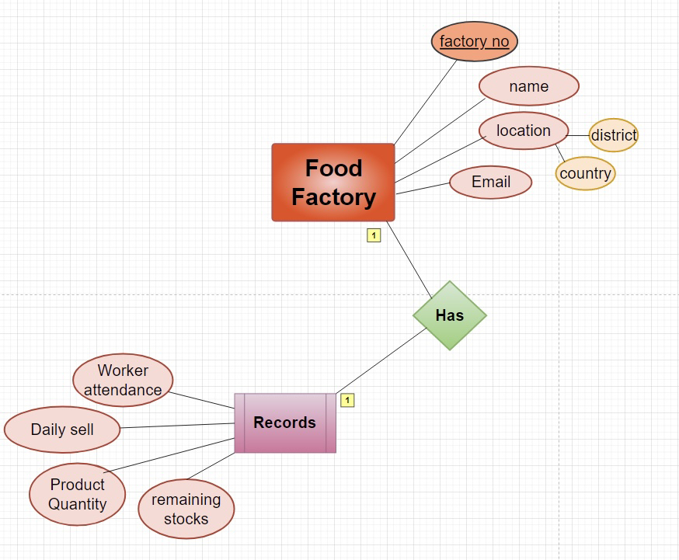
RELATIONSHIP BETWEEN ENTITY
Food factory has records
One food factory has one record

Slide 9
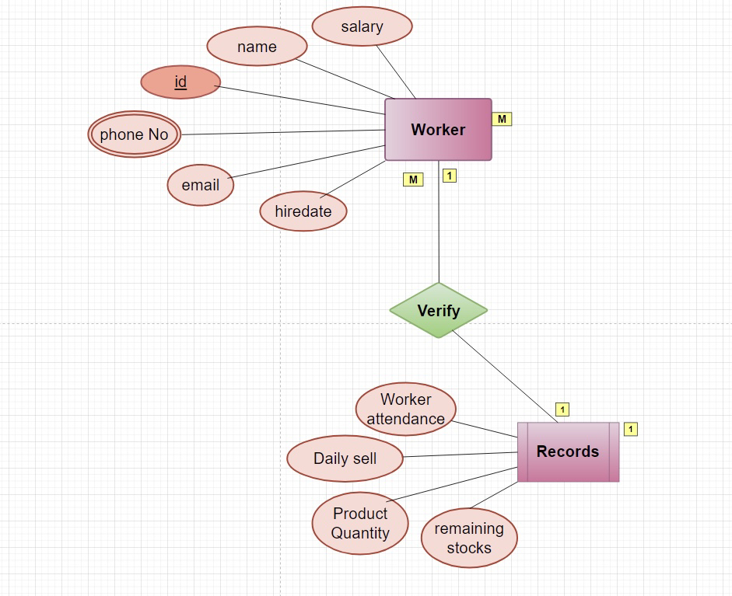
RELATIONSHIP BETWEEN ENTITY
Worker verify records
One worker verify one record

Slide 10
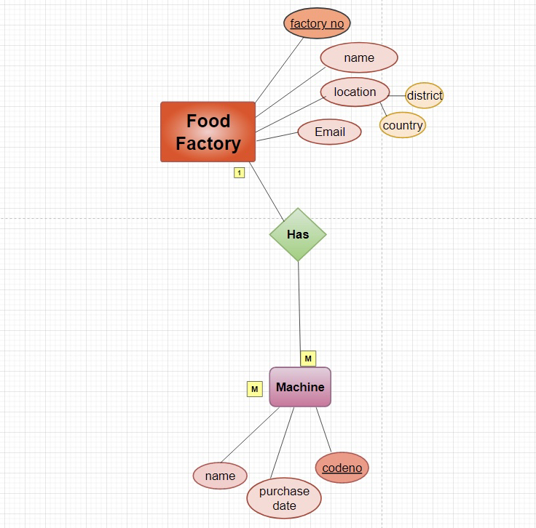
RELATIONSHIP BETWEEN ENTITY
Food factory has machine
One food factory has many machine

Slide 11
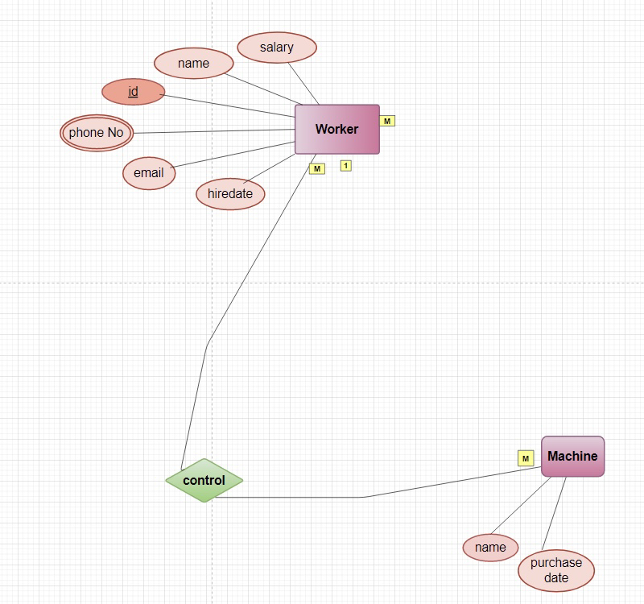
RELATIONSHIP BETWEEN ENTITY
Worker control machine
Many worker control many machine

Slide 12
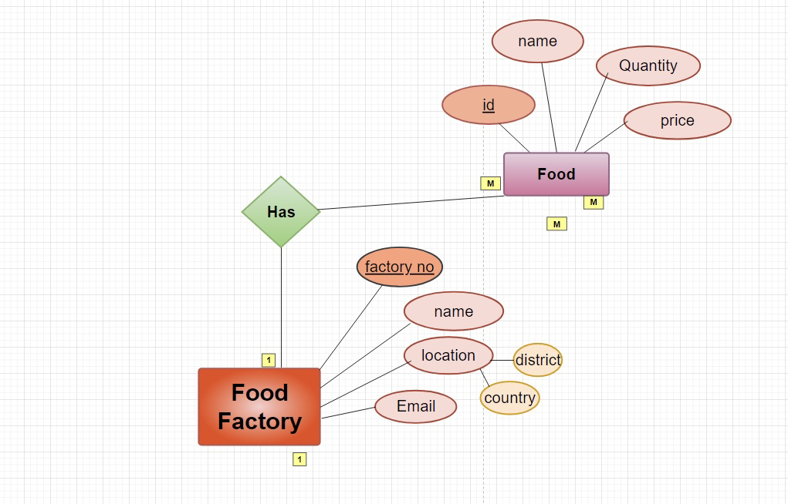
RELATIONSHIP BETWEEN ENTITY
Food factory has food
One food factory has many food

Slide 13
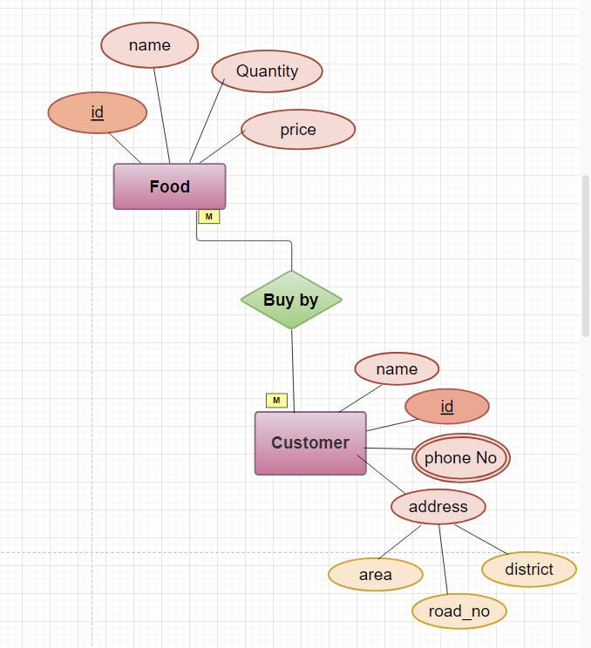
RELATIONSHIP BETWEEN ENTITY
Food buy by customer
Many food buy by many customer

Slide 14
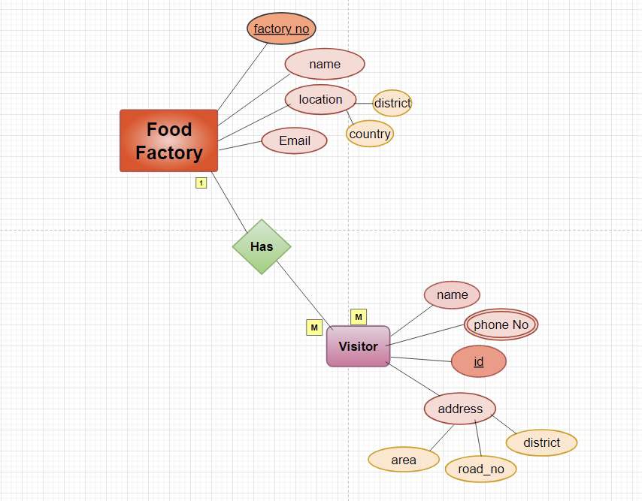
RELATIONSHIP BETWEEN ENTITY
Food factory has visitor
One food factory has many visitor

Slide 15
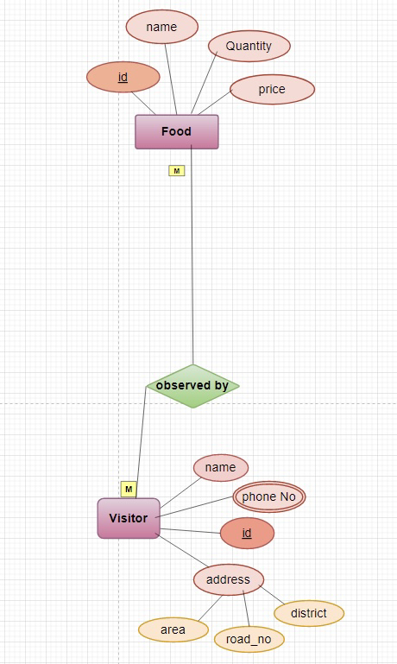
RELATIONSHIP BETWEEN ENTITY
Food observe by visitor
Many food observed by many visitor

Slide 16

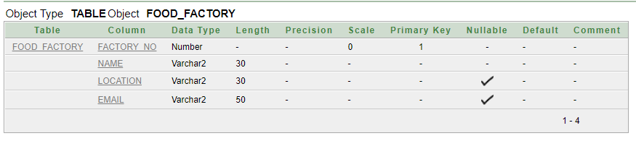
TABLE CREATION : presented by ABIR
1. CREATE TABLE FOOD_FACTORY ( FACTORY_NO SMALLINT PRIMARY KEY, NAME VARCHAR (30) NOT NULL, LOCATION VARCHAR (30), EMAIL VARCHAR (50),
HIREDATE VARCHAR(40) );

Slide 17
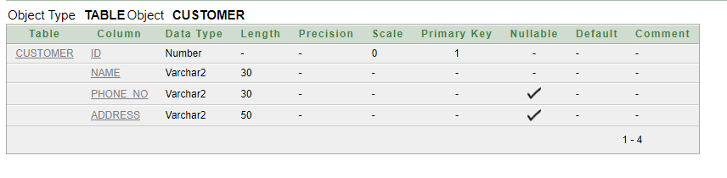
2.CUSTOMER CREATE TABLE CUSTOMER ( ID VARCHAR(20) PRIMARY KEY, NAME VARCHAR (30), PHONE_NO VARCHAR (30), ADDRESS VARCHAR(50) );

Slide 18
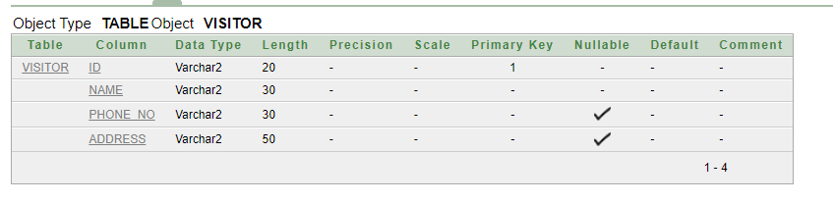
3.VISITOR CREATE TABLE VISITOR ( ID VARCHAR(20) PRIMARY KEY, NAME VARCHAR (30), PHONE_NO VARCHAR (30), ADDRESS VARCHAR(50) );

Slide 19
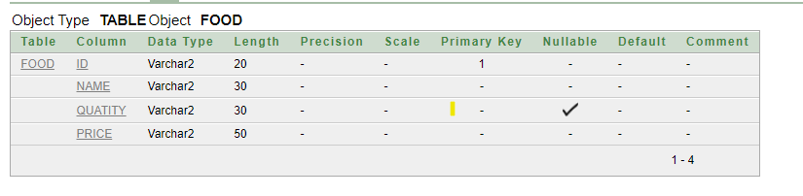
4. CREATE TABLE FOOD ( ID VARCHAR(20) PRIMARY KEY, NAME VARCHAR (30), QUATITY VARCHAR (30), PRICE VARCHAR(50) );

Slide 20
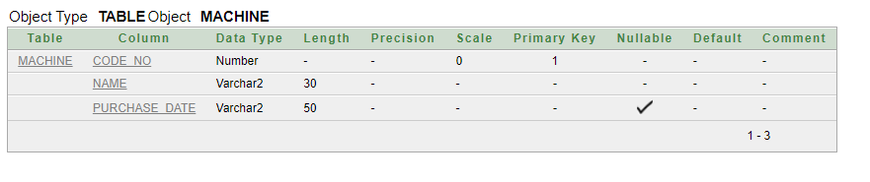
5.MACHINE CREATE TABLE MACHINE ( NAME VARCHAR (30), CODE_NO SMALLINT, PURCHASE_DATE VARCHAR(50) );

Slide 21
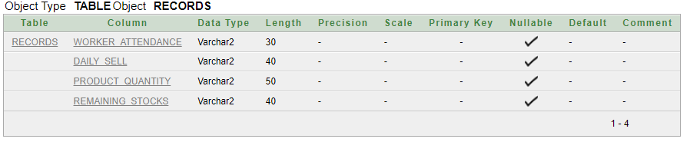
6. RECORDS CREATE TABLE RECORDS ( WORKER_ATTENDANCE VARCHAR (30), DAILY_SELL VARCHAR (40), PRODUCT_QUANTITY VARCHAR(50), REMAINING_STOCKS VARCHAR (40) );

Slide 22
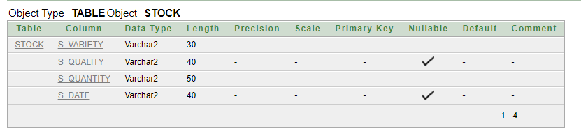
7. STOCK CREATE TABLE STOCK ( S_VARIETY VARCHAR(30), S_QUALITY VARCHAR (40), S_QUANTITY VARCHAR(50), S_DATE VARCHAR (40) );

Slide 23
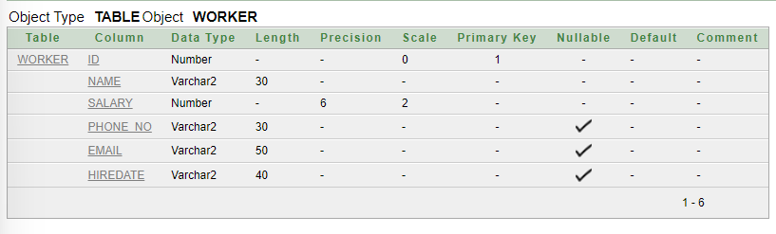
8. Worker
CREATE TABLE WORKER
(
ID VARCHAR(20) PRIMARY KEY,
NAME VARCHAR (30),
SALARY VARCHAR(35),
PHONE_NO VARCHAR (30),
EMAIL VARCHAR(50),
HIREDATE VARCHAR(40)
);

Slide 24
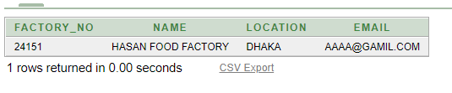
—DATA INSERTATION
INSERT INTO FOOD_FACTORY
VALUES
(24151,'HASAN FOOD FACTORY','DHAKA’, ‘AAAA@GAMIL.COM');

Slide 25
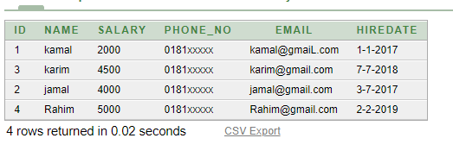
—DATA INSERTATION
INSERT INTO WORKER
VALUES
(1,'kamal','2000','0181xxxxx’, ‘kamal@gmaiL.com','1-1-2017');
INSERT INTO WORKER
VALUES
(3,'karim','4500','0181xxxxx’, ‘karim@gmail.com','7-7-2018');
INSERT INTO WORKER
VALUES
(2,'jamal','4000','0181xxxx’, ‘jamal@gmail.com','3-7-2017');
INSERT INTO WORKER
VALUES
(4,'Rahim','5000','0181xxxxx’, ‘Rahim@gmail.com','2-2-2019');

Slide 26
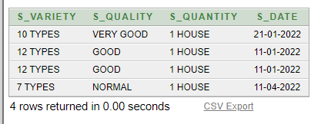
—DATA INSERTATION
INSERT INTO STOCK
VALUES
('10 TYPES','VERY GOOD','1 HOUSE','21-01-2022');
INSERT INTO STOCK
VALUES
('12 TYPES','GOOD','1 HOUSE','11-01-2022');
INSERT INTO STOCK
VALUES
('12 TYPES','GOOD','1 HOUSE','11-01-2022');
INSERT INTO STOCK
VALUES
('7 TYPES','NORMAL','1 HOUSE','11-04-2022');

Slide 27
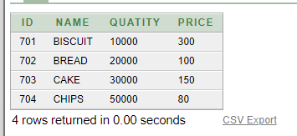
—DATA INSERTATION
INSERT INTO FOOD
VALUES
(701,'BISCUIT','10000','300');
INSERT INTO FOOD
VALUES
(702,'BREAD','20000','100');
INSERT INTO FOOD
VALUES
(703,'CAKE','30000','150');
INSERT INTO FOOD
VALUES
(704,'CHIPS','50000','80');

Slide 28
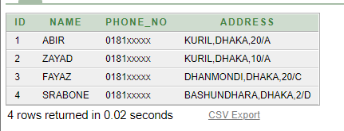
—DATA INSERTATION
INSERT INTO CUSTOMER
VALUES
(1,'ABIR','0181xxxxx','KURIL, DHAKA,20/A');
INSERT INTO CUSTOMER
VALUES
(2,'ZAYAD','0181xxxxx','KURIL, DHAKA,10/A');
INSERT INTO CUSTOMER
VALUES
(3,'FAYAZ','0181xxxxx','DHANMONDI, DHAKA,20/C');
INSERT INTO CUSTOMER
VALUES
(4,'SRABONE','0181xxxxx','BASHUNDHARA, DHAKA,2/D');

Slide 29
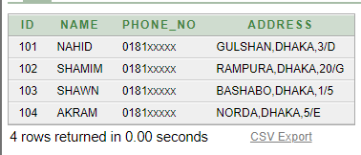
—DATA INSERTATION
INSERT INTO VISITOR
VALUES
(101,'NAHID','0181xxxxx','GULSHAN, DHAKA,3/D');
INSERT INTO VISITOR
VALUES
(102,'SHAMIM','0181xxxxx','RAMPURA, DHAKA,20/G');
INSERT INTO VISITOR
VALUES
(103,'SHAWN','0181xxxxx','BASHABO, DHAKA,1/5');
INSERT INTO VISITOR
VALUES
(104,'AKRAM','0181xxxxx','NORDA, DHAKA,5/E');

Slide 30
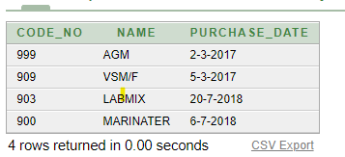
—DATA INSERTATION
INSERT INTO MACHINE
VALUES
('999','AGM','2-3-2017');
INSERT INTO MACHINE
VALUES
('909','VSM/F','5-3-2017');
INSERT INTO MACHINE
VALUES
('903','LABMIX','20-7-2018');
INSERT INTO MACHINE
VALUES
('900','MARINATER','6-7-2018');

Slide 31
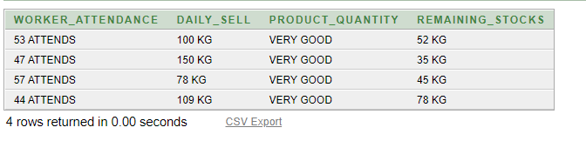
—DATA INSERTATION
INSERT INTO RECORDS
VALUES
('53 ATTENDS','100 KG','VERY GOOD','52 KG');
INSERT INTO RECORDS
VALUES
('47 ATTENDS','150 KG','VERY GOOD','35 KG');
INSERT INTO RECORDS
VALUES
('57 ATTENDS','78 KG','VERY GOOD','45 KG');
INSERT INTO RECORDS
VALUES
('44 ATTENDS','109 KG','VERY GOOD','78 KG');

Slide 32
NORMALIZATION
Normalization is a database design technique that reduces data redundancy and eliminates undesirable characteristics like insertion, update, and deletion anomalies. Normalization rules divides larger tables into smaller tables and links them using relationships.
1NF:
First Normal Form does not contain composite or multivalued attributes.
Example:
Table VISITOR:
Before 1NF:

Slide 33
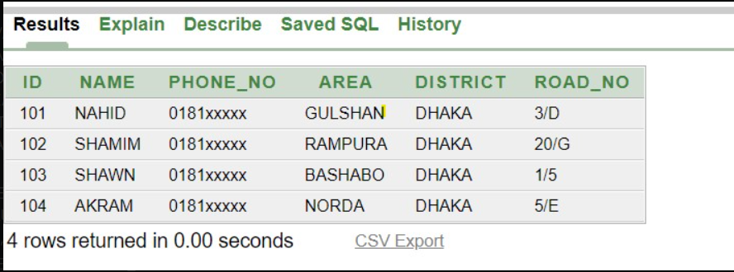
AFTER 1NF

Slide 34
BEFORE 2NF

Slide 35
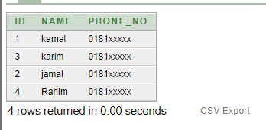
AFTER 2NF
Table 1

Slide 36
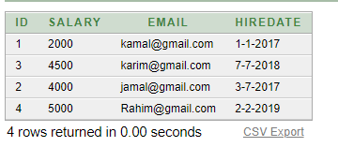
AFTER 2NF
Table 2

Slide 37
3NF
If there is no transitive dependency for non-prime attributes as well as it is in Second Normal Form.Transitive Dependency is a functional dependency between two or more non-key attributes.
In our diagram, 3NF is not applicable.

Slide 38
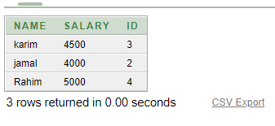
QUERIES
Using SUBQUERY to show NAME, SALARY, ID of the Workers where their SALARY are greater than ‘kamal’.
SELECT NAME, SALARY, ID
FROM WORKER
WHERE SALARY >
(SELECT SALARY
FROM WORKER
WHERE NAME = 'kamal'
);

Slide 39
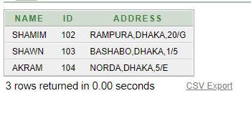
QUERIES
Using MULTIPLE-ROW SUBQUERY with ANY (It compares value to each value returned by the subquery) operator to show NAME, ID, ADDRESS from VISITOR table where IDs are greater than the ID of ‘NAHID’.
SELECT NAME, ID, ADDRESS
FROM VISITOR
WHERE ID > ANY
(SELECT ID
FROM VISITOR
WHERE NAME = 'NAHID'
);

Slide 40
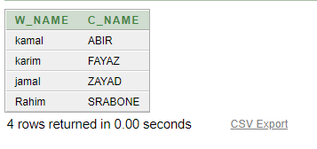
QUERIES
Using Table Alice in table WORKER & CUSTOMER to show the NAME of the workers & customers where their IDs are same in digit.
SELECT WORKER.NAME AS W_NAME, CUSTOMER.NAME AS C_NAME
FROM WORKER, CUSTOMER
WHERE WORKER.ID = CUSTOMER.ID;

Slide 41
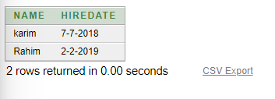
QUERIES
Using SINGLE-ROW SUBQUERY from table WORKER to show NAME, HIREDATE where PHONE_NO is equal to the worker whose ID is 2 and also their(worker) SALARYs are more than his SALARY whose ID is 2
SELECT NAME, HIREDATE
FROM WORKER
WHERE PHONE_NO =
(SELECT PHONE_NO
FROM WORKER
WHERE ID= 2)
AND SALARY >
(SELECT SALARY
FROM WORKER
WHERE ID= 2);

Slide 42
QUERIES
Using Table Alice in table WORKER & CUSTOMER to show the NAME of the workers & customers where their IDs are same in digit.
SELECT WORKER.NAME AS W_NAME, CUSTOMER.NAME AS C_NAME
FROM WORKER, CUSTOMER
WHERE WORKER.ID = CUSTOMER.ID;

Slide 43
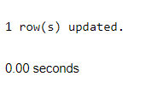
QUERIES
Updating Worker’s SALARY using specific condition
UPDATE WORKER
SET SALARY= (SALARY + 2000)
WHERE ID = 4;

Slide 44
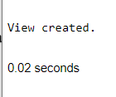
QUERIES
Creating a view from WORKER table
CREATE VIEW salvu40 AS
SELECT ID WORKER_NUMBER, NAME W_NAME, SALARY W_SALARY
FROM WORKER
WHERE ID = 3;

Slide 45
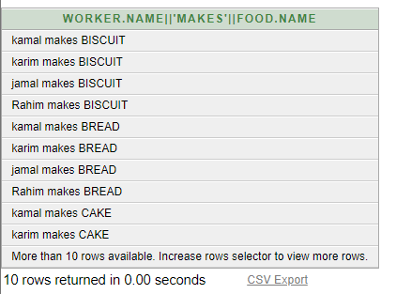
QUERIES
Joining a table ITSELF
SELECT WORKER.NAME || ' makes ' || FOOD.NAME
FROM WORKER, FOOD
WHERE WORKER.SALARY < > FOOD.PRICE;

Slide 46
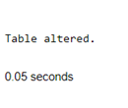
QUERIES
CHECK Constraint
ALTER TABLE WORKER
ADD AGE SMALLINT
CHECK (AGE>=18);

Slide 47
CONCLUSION
This is a very small scenario of a “Food Factory Management System”. The main lacking of this application is its small feature. In real life the management system is very big and huge, and it stores huge amount of data. But it might be helpful for beginners, who want to gain ideas about this management system and want to start a new beginning in this profession.
As we are the new learners in this database platform, we try our best to make this management system more connected in real life. Hope you will pardon our mistakes.

Slide 48
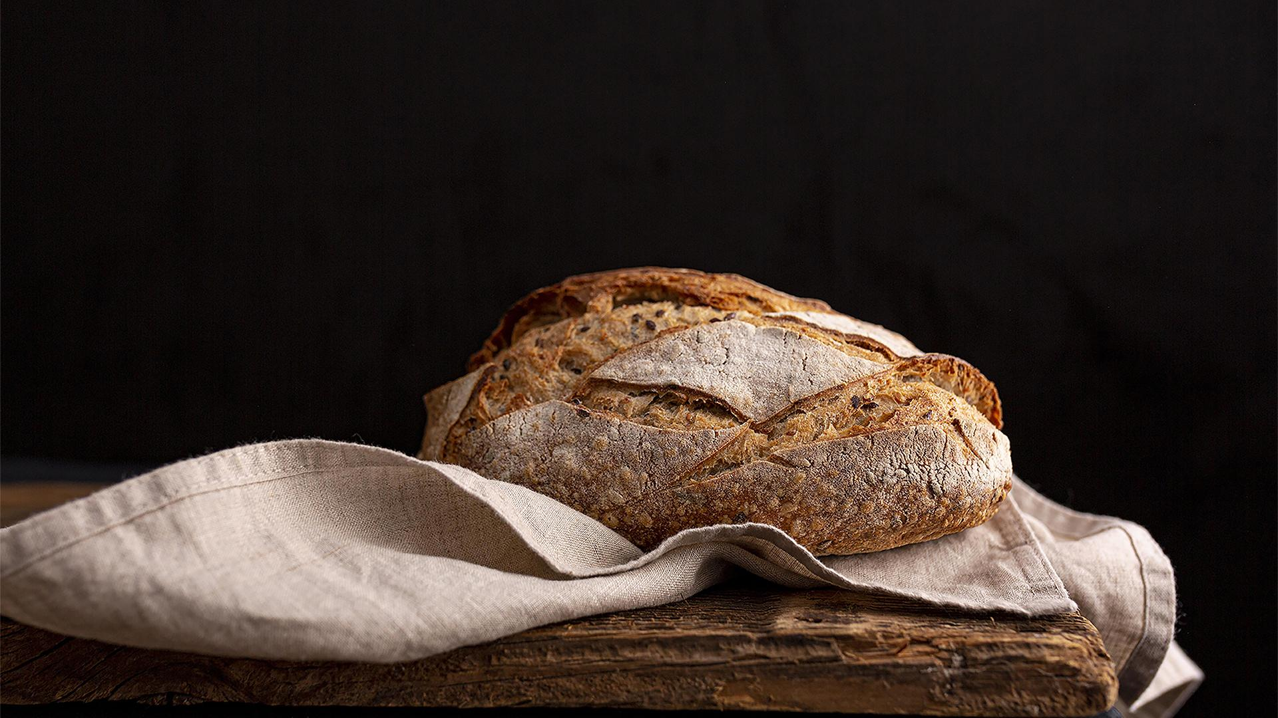
THANKS EVERYONE !!!

